Slide 1
GABot
Presented By -
Aditya Godambe 1311020
Chinmay Karanjkar 1311028
Ashutosh Mahajan 1311033

Slide 2
Outline
Problem Definition
Scope
Hardware/Software requirements
Literature Survey
Proposed system model
Project plan
Analysis and Design
Use case diagram
Screenshots of prototype model
Implemenatation
Conclusion
References

Slide 3
Problem Definition
GPS Autonomous Bot, aka GABot, is a prototype of GPS based driverless vehicle.
The problem defintion of this project is to implement an autonomous vehicle with no human interference using image processing for object detection and Arduino for hardware control.

Slide 4
Hardware requirements
Arduino.
Basic robot building material.
Wheels
Chassis
Motors, Servos
Camera
Proximity Sensors
Laptop

Slide 5
Software requirements
Matlab, for Image Processing
Arduino IDE, for Arduino Programming.
 Integration will be done between hardware and software using Matlab – Arduino interfacing library files

Slide 6
Literature Survey
This section summarises the most relevant research related to the construction and function of a driverless car and all the necessary information related to its implementation.
It also describes the current work being done in this area and the existing models along with the features of this project.

Slide 7
Introduction
Due to the recent advancement in the technology of Radar, LIDAR, neural networks and image processing it has become easy to introduce automation even in vehicles.
We are implementing features such as object detection traffic signal detection and roads and detection currently.
The papers demonstrate the algorithms and processes which are being used to implement the modules as mentioned above.

Slide 8
Existing research
Video Image Processing for Moving Object Detection and Segmentation using Background Subtraction By Answara Mohan and Resmi R, Department Of Electronics and Telecommunication, India
In this paper object detection and segmentation is proposed and they are compared using background subtraction algorithm (object detection) and segmentation algorithm (edge detection and thresholding).

Slide 9
Road-sign Segmentation and Recognition in Natural Scenes By Yang Siyan(Shaanxi Radio & TV University, Xi’an, China) and Wu Xiaoying Miao Qiguang(School of Computer Science and Technology, Xidian University, Xi’an, China)
The detection and recognition of road-sign is an important part of achieving intelligent vehicle. In the system, the HSI space is used to detect the road-sign which has been proposed.
Then the ratio of the size of road-sign and the size of the rectangle is used which is minimal and contain the road-sign to define the shape of the road-sign.

Slide 10
Features to be adopted
Background subtraction using image segmentation
Morphological operators for refinement
Distinguishing of road signs by converting RGB to HSV system and using shape detection.

Slide 11
Limitations
Unable to perform vision operations in case of adverse environmental factors.

Slide 12
Conclusion of Literature Survey
Based on the literature survey done, our project incorporates all the necessary features required by a driverless car such as object detection, road sign and traffic signal detection using the algorithms and procedures explained in the chosen papers.

Slide 13
Proposed system model

Slide 14
Project plan
The project tasks have been primarily classified as below
Tools and resources gathering
Requirement analysis
System Design
Development of an exploratory prototype and getting feedback

Slide 15
Task 1: Tools and resources gathering
Hardware requirement gathering process - Identifying the correct microprocessors, motor drivers and all the other basic robotic components
Software requirement gathering process - Installation of Matlab software and Arduino IDE.
Deliverables and milestones
Finding relevant technical papers containing algorithms which shall be used for implementation.
Identifying key points from the papers required to implement the proposed features.

Slide 16
Task 2: Requirements Analysis
Identification of prime functional requirements
Obstacle detection
Traffic signal and road sign detection
Appropriate robotic movement in accordance to the first two requirements.
Software documentation such as SRS, SPMP and STD and hardware feedback logs.
Deliverables and milestones
Delivery of the current drafts of SRS, SPMP and STD.
Complete understanding of all the requirements by the group members.

Slide 17
Task 3: System Design
This task involves the designing of -
The robot’s hardware design
The architecture of the software
Deliverables and milestones
Designing the chassis of the robot
Designing the system architecture of the software
Drawing the relevant UML diagrams such as use cases and sequence diagrams

Slide 18
Task 4: Development of an exploratory prototype and getting feedback
Deliverables and milestones
Traffic signal detection module
Road sign detection module
Objection detection module
Performance observation and feedback documentation

Slide 19
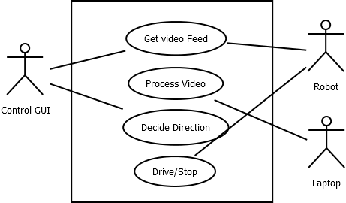
Analysis and Design
Diagrams – Use Case Top Level

Slide 20
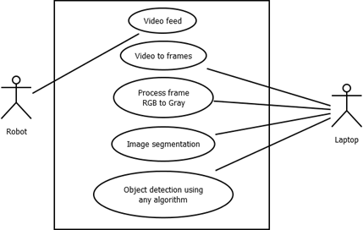
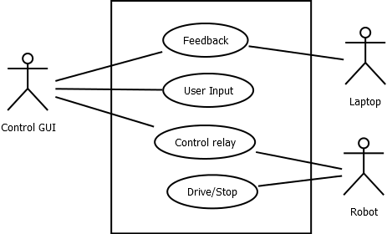
Diagrams – System Architecture

Slide 21
Screenshots of Prototype model

Slide 22
Algorithms
Currently implemented
Background subtraction for object detection
Colour detection algorithm for traffic signal detection
To be implemented
Hough algorithm

Slide 23
Existing implementation
Frame Splitting
Controlling number of frames
Object detection using Morphological Operators (still images)
Object detection using Background Subtraction (video images)
Traffic signal detection

Slide 24
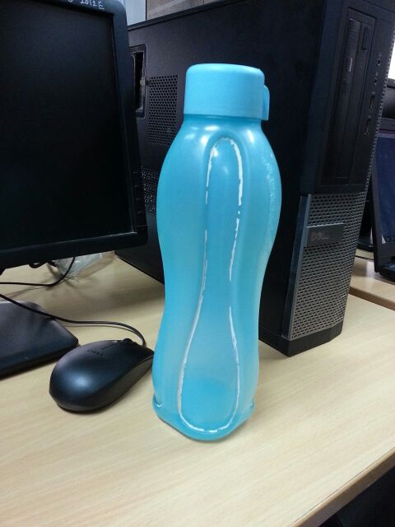
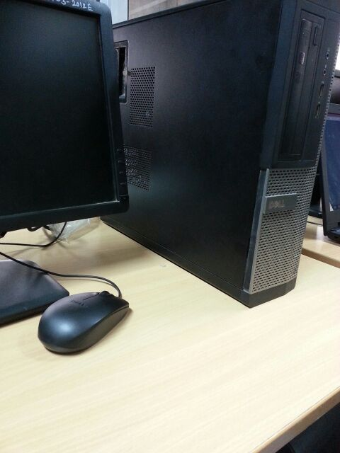
Implementation of Background subtraction algorithm to still images
Foreground
Background

Slide 25
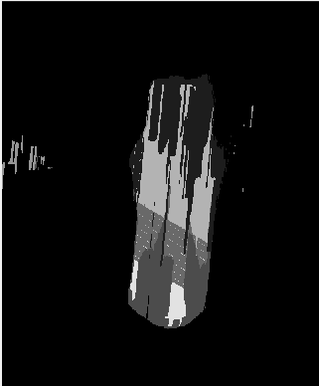
Conversion of foreground to gray-scaled intermediate stage

Slide 26
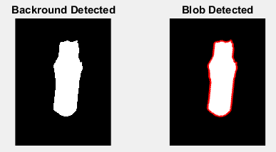
Final object detection using blob analysis

Slide 27
Traffic detection
Traffic detection by the bot – By demonstration

Slide 28
Conclusion
Thus we conclude that this project is just awesome.

Slide 29
References

